Slide 1
Chapter 2: Intro to Relational Model

Slide 2

Example of a Relation
attributes
(or columns)
tuples
(or rows)
00000 – 99999
Nmae ------ (fname, mname, lname)

Slide 3
Attribute Types
The set of allowed values for each attribute is called the domain of the attribute
Attribute values are (normally) required to be atomic; that is, indivisible
The special value null is a member of every domain. Indicated that the value is “unknown”
The null value causes complications in the definition of many operations
Difference between Unique and Atomic

Slide 4
Relation Schema and Instance
A₁, A₂, …, A_{n} are attributes
R = (A₁, A₂, …, A_{n} ) is a relation schema
Example:
instructor = (ID, name, dept_name, salary)
Formally, given sets D₁, D₂, …. D_{n} a relation r is a subset of
D₁ x D₂ x … x D_{n}
Thus, a relation is a set of n-tuples (a₁, a₂, …, a_{n}) where each a_{i} ∈ D_{i}
The current values (relation instance) of a relation are specified by a table
An element t of r is a tuple, represented by a row in a table

Slide 5

Relations are Unordered
Order of tuples is irrelevant (tuples may be stored in an arbitrary order)
Example: instructor relation with unordered tuples

Slide 6
Keys
Let K ⊆ R
K is a superkey of R if values for K are sufficient to identify a unique tuple of each possible relation r(R)
  Example: {ID} and {ID,name} are both superkeys of instructor.
Superkey K is a candidate key if K is minimal
Example: {ID} is a candidate key for Instructor
One of the candidate keys is selected to be the primary key.
  which one?
Foreign key constraint: Value in one relation must appear in another
  Referencing relation
  Referenced relation
  Example – dept_name in instructor is a foreign key from instructor referencing department

Slide 7
R = {roll_no, Dept, year, sem, name, address}
Composite key
R = {Stud-code, Adhar-Id, name, address}
Stud_code
Stud_code, name
Stud_code,address
Stud_code,name.address
Adhar_Id
Adhar_is,Stud_cde

Slide 8
R = {roll_no, Dept, year, sem, Adhaar_ID, name, address}
  Roll_no,Dept,Year,Sem
  Adhaar_ID
  Adhaar_ID,Dept
  Candidate key : Undivasable SK
    Roll_no,Dept,Year,Sem
    Adhaar_ID

Slide 9
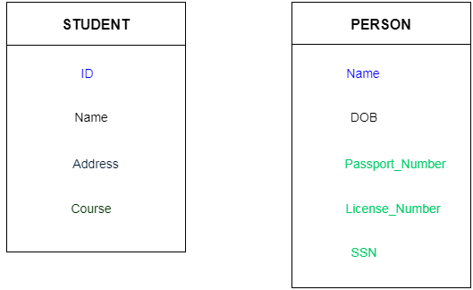
Keys (cont)
used to uniquely identify any record or row of data from the table.
used to establish and identify relationships between tables.
For example:
  Student table, ID is used as a key because it is unique for each student.
  PERSON table, passport_number, license_number, SSN are keys since they are unique for each person.

Slide 10
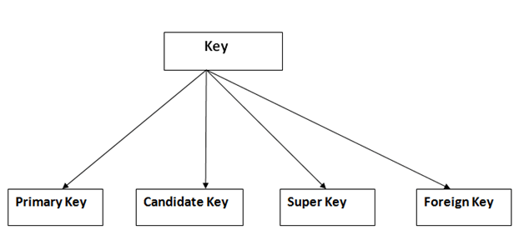
Types of key

Slide 11
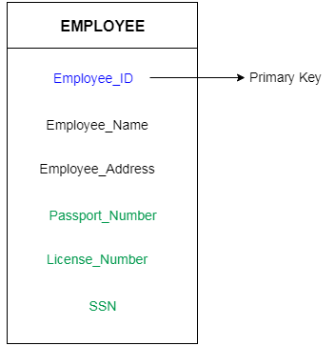
Types of key : Primary Key
Primary key
  The first key which is used to identify one and only one instance of an entity uniquely.
  An entity can contain multiple keys
  The key which is most suitable from those lists become a primary key.
  E.g. EMPLOYEE table,
    ID can be primary key since it is unique for each employee.
    License_Number and Passport_Number as primary key since they are also unique.
  For each entity, selection of the primary key is based on requirement and developers.

Slide 12
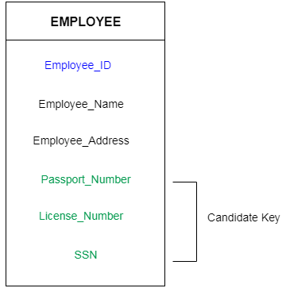
Types of key : Candidate Key
A candidate key is an attribute or set of an attribute which can uniquely identify a tuple.
The remaining attributes except for primary key are considered as a candidate key. The candidate keys are as strong as the primary key.
E.g. EMPLOYEE table:
  id is best suited for the primary key.
  Rest of the attributes like SSN, Passport_Number, and License_Number, etc. are considered as a candidate key.
  Eg {employee_id}, {Pass_no}, {L_num},{SSN}, {e_name, e_add}
  Alternate Keys

Slide 13
Types of key : Super Key
a set of an attribute which can uniquely identify a tuple.
Super key is a superset of a candidate key.
EMPLOYEE table,
  (EMPLOEE_ID, EMPLOYEE_NAME) the name of two employees can be the same, but their EMPLYEE_ID can't be the same. Hence, this combination can also be a key.
  The super key would be EMPLOYEE-ID, (EMPLOYEE_ID, EMPLOYEE-NAME), etc.
  Unit key/Composite Key
  {{Employee_id, Employee_name},
  {Employee_id, Employee_address}, {Employee_id},
  {Passport_Number}, {Passport_number,Employee_name}}

Slide 14
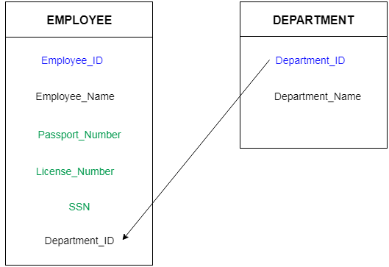
Types of key : Foreign Key
The column of the table which is used to point to the primary key of another table.
  E.g. In a company, every employee works in a specific department, and employee and department are two different entities.
  the information of the Employee and Department are in the employee table.
  Link these two tables through the primary key of one table.
Steps:
  Add the primary key of the DEPARTMENT table, Department_Id as a new attribute in the EMPLOYEE table.
  Now in the EMPLOYEE table, Department_Id is the foreign key, and both the tables are related.

Slide 15
Student Table
Student_Number | Student_Name | Student_Phone | Subject_Number
1 | Andrew | 6615927284 | 10
2 | Sara | 6583654865 | 20
3 | Harry | 4647567463 | 10
The Super Keys −
{Student_Number} {Student_Phone} {Student_Number,Student_Name} {Student_Number,Student_Phone} {Student_Number,Subject_Number} {Student_Phone,Student_Name} {Student_Phone,Subject_Number} {Student_Number,Student_Name,Student_Phone} {Student_Number,Student_Phone,Subject_Number} {Student_Number,Student_Name,Subject_Number} {Student_Phone,Student_Name,Subject_Number}
The Candidate Key
{Student_Number}
{Student_Phone}
{Student_name, Subject_Number}
The Primary Key : {Student_Number}

Slide 16

Schema Diagram for University Database

Slide 17
Relational Query Languages
Procedural vs .non-procedural, or declarative
“Pure” languages:
  Relational algebra
  Tuple relational calculus
  Domain relational calculus
The above 3 pure languages are equivalent in computing power
We will concentrate in this chapter on relational algebra
  Not turning-machine equivalent
  consists of 6 basic operations

Slide 18

Select Operation (σ)– selection of rows (tuples)
Relation r
σ_{A=B ^ D > 5} (r)
σ (r) : Select * from r : ∏ (r)
∏_{A,B, C} (r) : Select a,b,c from r
σ_{A=B ^ D > 5} (r) : Select * from r where a=b .and. d>5
σ_{A=B ^ D > 5} (r) : Select * from r where a=b .and. d>5
∏_{A,B,D} (σ_{A=B ^ D > 5} (r) ) : Select a,b,d * from r where a=b .and. d>5
σ_{A=B ^ D > 5 (}∏_{A,B,D} (r)

Slide 19

Project Operation – selection of columns (Attributes)
Relation r:
∏_{A,C} (r)
Select c,a from r;
Select distinct A from r
Select count(*) from r
Select count(A) from r
Select count (distinct A) from r
Select count(A) from (select distinct A from r)
Select distinct (concat(A,C) ) from r

Slide 20

Union of two relations
Relations r, s:
r ∪ s:
Select * from r Union
Select * from s
By default only distinct value will be in result
Select * from r union all
Select * from s
Each SELECT statement within UNION must have the same number of columns
The columns must also have similar data types
The columns in each SELECT statement must also be in the same order

Slide 21

Set difference of two relations
Relations r, s:
r – s:
select * from r
Minus
Select * from s
List records from r which are not present in s

Slide 22

Set intersection of two relations
Relation r, s:
r ∩ s
Note: r ∩ s = r – (r – s)
Select * from r
Intersect
Select * from s
List common records from r and s

Slide 23

joining two relations -- Cartesian-product
Relations r, s:
r x s:
Select * from r,s

Slide 24
Cartesian-product – naming issue
B
Relations r, s:
r.B
s.B
r x s:
https://www.w3schools.com/sql/sql_alias.asp

Slide 25
Renaming a Table
Allows us to refer to a relation, (say E) by more than one name.
ρ _{x} (E)
returns the expression E under the name X
Relations r
r.A r.B s.A s.B
r x ρ _{s} (r)
α
α
β
β
1
1
2
2
α
β
α
β
1
2
1
2
Select * from r, r
Select * from r , r as s
Select r.a, r.b, s.a, s.b

Slide 26

Composition of Operations
Can build expressions using multiple operations
Example: σ_{A=C} (r x s)
r x s
σ_{A=C} (r x s)
Select * from r,s where r.a = s.c

Slide 27
Joining two relations – Natural Join
Let r and s be relations on schemas R and S respectively.
Then, the “natural join” of relations R and S is a relation on schema R ∪ S obtained as follows:
  Consider each pair of tuples t_{r} from r and t_{s} from s.
  If t_{r} and t_{s} have the same value on each of the attributes in R ∩ S, add a tuple t to the result, where
    t has the same value as t_{r} on r
    t has the same value as t_{s} on s

Slide 28

Natural Join Example
Relations r, s:
Natural Join
  r s
∏ _{A, r.B, C, r.D, E} (σ _{r.B = s.B ˄ r.D = s.D} (r x s)))

Slide 29
Notes about Relational Languages
Each Query input is a table (or set of tables)
Each query output is a table.
All data in the output table appears in one of the input tables
Relational Algebra is not Turning complete
Can we compute:
  SUM
  AVG
  MAX
  MIN

Slide 30
Summary of Relational Algebra Operators
Symbol (Name) Example of Use
σ
(Selection) ^{σ} salary > = 85000 ^{(instructor)}
Return rows of the input relation that satisfy the predicate.
Π
(Projection) ^{Π} ID, salary ^{(instructor)}
Output specified attributes from all rows of the input relation. Remove duplicate tuples from the output.
x
(Cartesian Product) instructor x department
Output pairs of rows from the two input relations that have the same value on all attributes that have the same name.
∪
(Union) ^{Π} name ^{(instructor) ∪ Π} name ^{(student)}
Output the union of tuples from the two input relations.
-
(Set Difference) ^{Π} name ^{(instructor)} ^{-- Π} name ^{(student)}
Output the set difference of tuples from the two input relations.
⋈
(Natural Join) instructor ⋈ department
Output pairs of rows from the two input relations that have the same value on all attributes that have the same name.

Slide 31
End of Chapter 2

